Slide 1
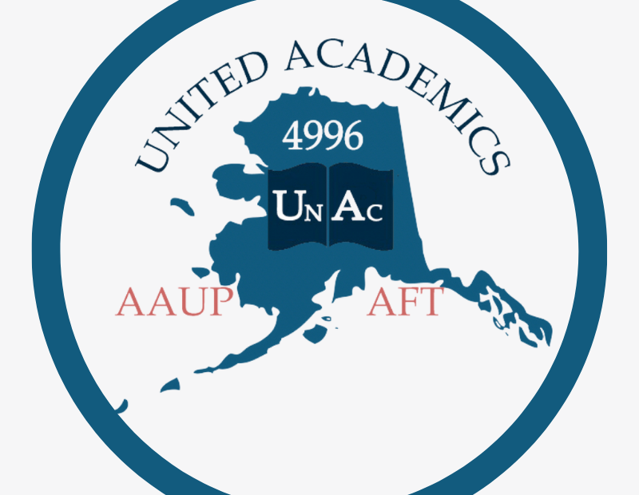
General MembershipMeeting
Jill Dumesnil, President
Notes:
Welcome to our October General Membership Meeting. We are glad you are here. I am Jill Dumesnil, President of United Academics AAUP/AFT Local 4996. The agenda for tonight is to give an overview of our bargaining process to date and then take questions from you. We are interested to hear your perspectives, concerns, and feedback.

Slide 2
Land Acknowledgement
We live and work on the unceded territories of Alaska Native Peoples. We very much appreciate their past and ongoing stewardship of these lands.
Notes:
We begin every union meeting with a land acknowledgement and a statement on social equity and racial justice in the UA System. We live and work on the unceded territories of Alaska Native Peoples. We very much appreciate their past and ongoing stewardship of these lands.

Slide 3
Anti-racism, Anti-colonialism, Anti-discrimination Statement
As part of our commitment to enkindle racial justice and social equity within the University of Alaska system, we will speak up when we experience examples of racism or injustice in our meetings and as we conduct our business.
This means we can and will interrupt the meeting to draw the issue to one another’s attention. We will do this kindly, with care, and in good faith. This statement is a reminder that we commit to doing this in the service of ending the system of racial oppression that is perpetuated through institutionalized policies and individual bias.
Notes:
As part of our commitment to enkindle racial justice and social equity within the University of Alaska system, we will speak up when we experience examples of racism or injustice in our meetings conduct our business.
This means we can and will interrupt the meeting to draw the issue to one another’s attention.
We will do this kindly, with care, and in good faith. This statement is a reminder that we commit to doing this in the service of ending the system of racial oppression that is perpetuated through institutionalized policies and individual bias.

Slide 4
Bargaining update
Notes:
The primary purpose of United Academics is to negotiate, enforce, and defend the Collective Bargaining Agreement that governs your working conditions. It’s important to note that the CBA trumps other policies including Faculty Handbooks and Board of Regents Policy.

Slide 5
Classification of Bargaining Topics
Mandatory Subjects
Permissive Subjects
Prohibited Subjects
Notes:
There have been discussions and questions about why UNAC doesn’t propose certain items be included in our CBA or delete certain articles. In the United States, bargaining subjects are classified into three categories: mandatory subjects, permissive subjects, and prohibited subjects.

Slide 6
Mandatory Subjects
Wages
Health & Safety
Working Conditions
Grievance Procedures
Discipline and Discharge
Workloads, Job Duties
Evaluation Procedures
Promotions
Health Insurance, Pensions, Dental and Vision Plans
Holidays, Sick Days
Transfers
No Strike Clause
Management Rights Clause
Notes:
Mandatory subjects are those that must be bargained if either party proposes them. Here’s a sample list of mandatory subjects. Notice that Management Rights is a mandatory subject in the U.S. Therefore, UNAC cannot delete the relevant article or refuse to bargain it if management desires. Similarly, management cannot refuse to bargain any of these issues. If we propose a different holiday schedule, UA has to at least pretend to consider our proposal.

Slide 7
Permissive Subjects
Negotiation Ground Rules
Make-up of either party’s Negotiation Team
Supervisor’s Conditions of Employment
Settlement of a ULP Charge
Recognition Clause Defining Bargaining Unit
Make-up of Employer’s Board of Directors
Internal Union Matters (elections, dues, structure, bylaws)
Notes:
Permissive subjects are those subjects than can be brought up, but either party can decline to discuss. If one party expresses the refusal to bargain on a topic, the topic must be dropped by the other party. Continuing to address such topics is grounds for a Unfair Labor Practice complaint.

Slide 8
Prohibited Subjects
Closed shop provisions
Discrimination against a group of employees
Hot cargo clauses (prohibiting employer from conducting business with some other entity)
Agreements in violation of statute
Agreements that are unenforceable as a matter of law
Notes:
Finally, there are prohibited (or illegal) subjects of bargaining. Essentially, anything that would be in violation of state or federal statute or unenforceable as a matter of law is prohibited. Therefore, we cannot introduce climate change or world peace into our negotiations although all of us care about such topics. Not only does neither party (UNAC or UA) control the outcome, but any such agreement would be unenforceable. Again, introducing prohibited subjects is grounds for a ULP complaint.

Slide 9
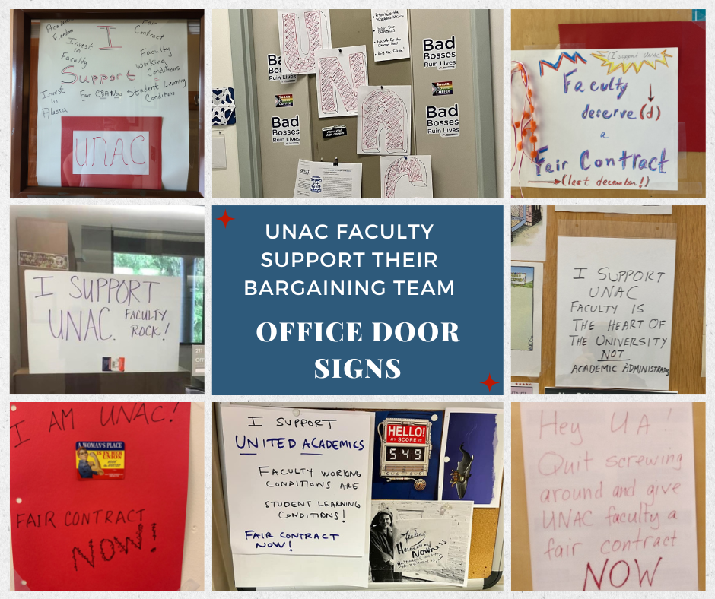
Preparation Timeline
UNAC Team selected – February, 2024
Team meetings – monthly since February, weekly since August
AAUP training – May 6 – 7, 2024
Team retreat in Fairbanks – July 8 – 12, 2024
UNAC sent ground rules proposal – May 17, 2024
Ground rules agreement – August 19, 2024
Notes:
In preparation for bargaining, United Academics selected its team according to our bylaws in February of 2024. The team met monthly from February to July and has met weekly since August. We had two days of AAUP bargaining training in May and spent a week at an in-person retreat in July where we created our bargaining strategy and drafted our proposals based on input from our bargaining survey, member input and testimony, and experience enforcing the current CBA.
We also sent our initial proposal for ground rules on May 17 but didn’t reach agreement with the UA team until August 19. Spending two months on email discussions of ground rules foreshadowed how difficult the actual negotiations would be.

Slide 10
Member Concerns
From 2018 to the present our members have lost over 15% of their purchasing power.
Salary compression/inequity is affecting many members.
Members report unfair and unequal treatment and working conditions.
Members are deeply concerned about the integrity and cost of our healthcare plan.
Notes:
We have heard from our members that the loss of purchasing power and salary compression and/or inequity are their biggest concerns.
In addition, members report the perception of unfair and unequal treatment regularly impacting their working conditions and job satisfaction. We believe that consistency and transparency in processes would go a long way toward resolving concerns.
Finally, our members are deeply concerned about the integrity and cost of our self-funded healthcare plan - especially given that there is no stop-loss coverage for reimbursement against catastrophic claims.

Slide 11
Legislative Context
The Alaska Legislature has never refused to appropriate union negotiated salary increases.
Notes:
Although often cited as a threat by public employers, to our knowledge the Alaska Legislature has never refused to appropriate union negotiated salary increases.
In fact, the Legislature has recently approved and appropriated several very generous pay packages negotiated by public employee unions.

Slide 12
Recent Public Sector CBA Wage Agreements
Local Union | Compound Increases | 2024 ATB increases | 2025 ATB increases | 2026 ATB increases | Step increases
Anchorage Police | 24.6% | 7.8% | 3.3% | 4.3% | Yes= approx 2.5%
APEA SU | 26.8% | Based on 2022 CPI up to 5% | Based on 2023 CPI up to 5% | Based on 2024 CPI up to 5%, not below 2.5% | Yes = 3.25%
Labor, Crafts & Trades Local 71 ASEA | 28.6% | Based on 2022 CPI of 5% | Based on 2023 CPI up to 5% | Based on 2024 CPI up to 5% | Yes= 2 step increase on 7/8/2024; 3.75% per step
Public Safety Employees Assoc (troopers, fire marshalls, court officers) | 25.6% | 7% (FY24) | 3% (FY25) | 10% (FY26) | Yes= 3.75% every two years
PSEA (DOT, Public Facilities) | 26.8% | 7% (FY24) | 4% (FY25) | 10% (FY26) | Yes= 3.75% every two years
Notes:
This table shows recent public sector CBA wage agreements as published on the Alaska Department of Administration, Division of Finance, Salary Schedule website (http://doa.alaska.gov/dof/payroll/sal_sched.html).
Note that all of these unions have annual or biannual step increases in addition to across-the-board raises, CBAs covering 2024 through 2026, and a compounded salary increase averaging 26.5% over the life of the contract.
This is why UNAC considered our original 5-5-5 proposal of a compound salary increase of 15.79% to be quite conservative.

Slide 13
Bargaining Timeline
Bargaining sessions with UA
August 19: UNAC presented its 5-5-5 proposal, UA caucused
August 20: UA canceled bargaining to caucus
September 3: UA canceled bargaining to consider our proposal and discuss with BOR on September 5
September 16: UA responded with 2.75-3-2.5. UNAC responded with 2.75-3-3.5 with increased minimum salaries, increases to department chair pay, overload pay, and summer pay and a 5% market pool.
September 17: UA countered with 2.75-3-2.75 and lower increases to minimum salaries, lower increases to department chair pay, overload pay, and summer pay and no market pool. UNAC responded with a package of 17 “no change” articles.
September 30: UA responded with a package of 12 of the “no change” articles. UNAC agreed to sign “tentative agreement” on those 12 articles. UNAC proposed package of the five remaining articles (9, 11, 13, 15, and 16).
October 1: First substantive discussion at the table. No proposals were passed.
Notes:
We began bargaining on August 19 with an opening presentation outlining our views and priorities for negotiation. In service of our members’ highest priority, we proposed salary increases of 5% per year with no other changes to the CBA. It’s not that we thought or think our current CBA is perfect, but we were willing to live with the status quo for significant raises.
As you know, UA then caucused for 4 weeks, met with the BOR, and countered with a proposal for 2.75, 3, and 2.5 percent raises. UA has other union contracts for 2.75% raises in FY26 and 3% raises in FY27 with “me, too” clauses they don’t want to trigger. In addition, President Pitney has committed to giving non-unionized staff the same raises that the unions negotiate. Therefore, it is unlikely that the UA team is authorized to agree to more than 2.75% in FY26 and 3% in FY27.
United Academics’ negotiation mantra is to “do the most good for the most members.” Therefore, UNAC countered with alternate ways to get the same amount of money in the hands of our bargaining unit members while recognizing the constraints for UA in FY26 and FY27. Our second proposal was 2.75-3-3.5 with increases to minimum salaries, increases to department chair pay, overload pay, and summer pay, with a 5% pool for market adjustments. The cost of this proposal was in line with the cost of the 5-5-5 proposal, but wouldn’t have triggered the “me,too” clauses that UA was trying to avoid.
The next day, the chief negotiator for UA launched into his lecture about the ambiguous and confusing concept of “market.” So, they responded with ATB raises of 2.75-3-2.75 and lower increases to minimum salaries, lower increases to department chair pay, overload pay, and summer pay and no market pool.
At this point, we knew that we could not accept their level of compensation without opening some additional articles to balance overall member concerns and needs. Therefore, we prepared a package proposal with 17 of the 22 articles having no changes or only administrative changes. We attempted to impress upon the management team that our members have been absorbing pay cuts in the form of lost purchasing power to continue working at UA and that the university has the ability to request sufficient funds from the Legislature to adequately pay employees. Their chief negotiator later accused us of “grandstanding.”
Last week, UA responded to our package by withholding five articles and giving us a package of 12 “no change” articles which we agreed to TA.
Then we presented a package of the five articles we had on our side of the table. Namely, articles 9, 11, 13, 15 and 16. I presented the proposal in detail at the table, because the UA team has been unwilling to stay at the table for any substantive discussion.
They’ve claimed not to understand our earlier proposals, but didn’t ask any questions or seek any clarification. We did have our first candid discussion at the table on October 1. They have indicated that they expect to have a package of the ten remaining articles for our consideration on October 14.
Our complete proposals are posted on our website, but UA marks their proposals as “confidential.” Thus, our legal counsel had advised us to summarize their proposals in our bargaining updates but not to post them publicly.

Slide 14
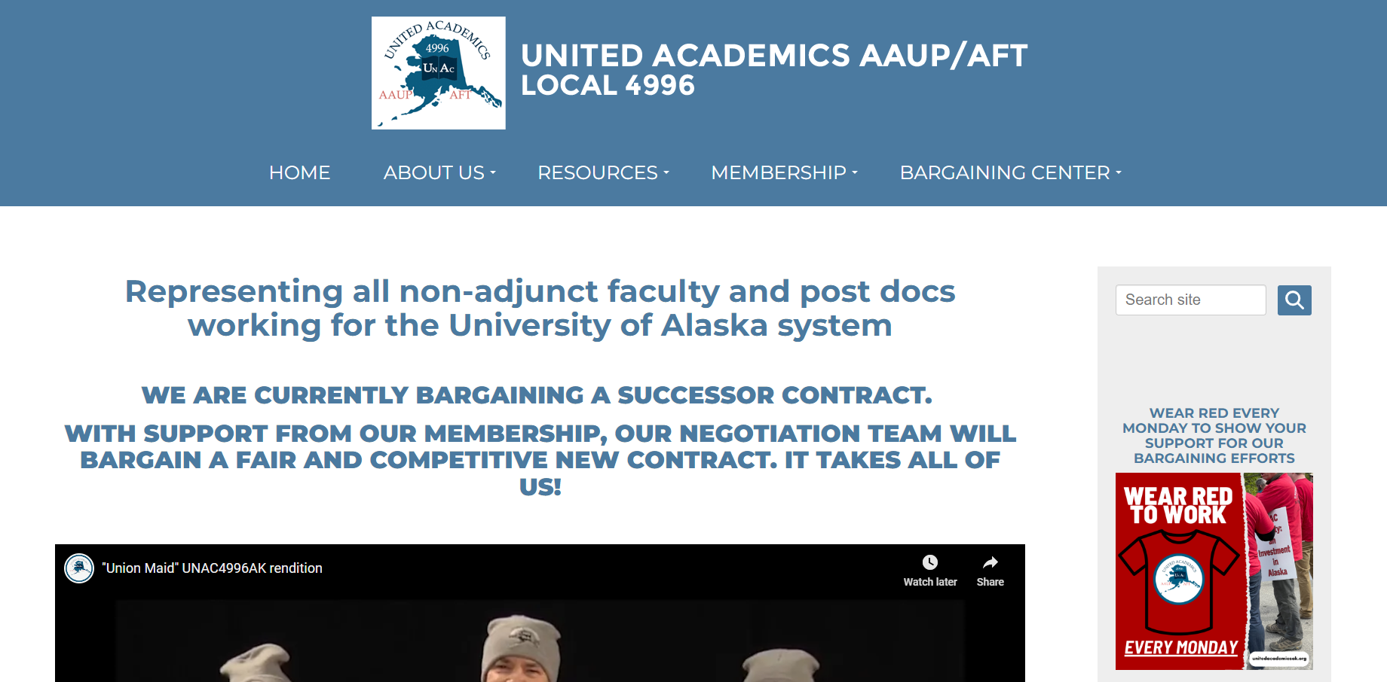
www.unitedacademicsak.org
Notes:
Under the Bargaining Center tab at our website, www.unitedacademicsak.org, you will find bargaining updates, bargaining proposals and presentations, negotiation team members, Zoom profile pictures you can use, and actions you can take to support our bargaining efforts and to put pressure on the management team to work with us to settle a fair and competitive contract. We cannot do it without you!

Slide 15
Upcoming Dates
October 14 – 15: Bargaining
October 28 – 29: Bargaining
November 7 – 8: Board of Regents meeting in Fairbanks
November 12: Bargaining
November 12: General Membership Meeting
Notes:
I’ve listed some upcoming dates of interest. Bargaining will continue next week on October 14-15, as well as on October 28-29.
The Board of Regents meeting on November 7-8 will be the meeting at which regents approve the FY26 budget for submission to the legislature. They have included increases to tuition and the 2.75% raises for everyone except UNAC and the adjuncts – as both unions have expiring contracts.
The university has made it quite clear that they have no intention of agreeing to retroactive raises, so if we don’t settle a contract in time for legislative appropriation our members with not get a raise in FY26. We need a BIG showing of members present at the BOR meeting. Please encourage anyone in Fairbanks on November 7 and 8 to make an effort to show solidarity by showing up!

Slide 16
Member Actions
Wear red shirts on Mondays
Observe bargaining sessions
Attend BOR meeting on 11/7 and 11/8
Write letters to BOR and PP
Write letters to editors or op-ed pieces
Talk to your colleagues
Notes:
Here is a list of member actions that will support our team in negotiating a fair and competitive contract for our members. Kate and the CCAT (Contract Campaign Action Team) are working on more ways you can help.

Slide 17
Steps to a Legal Strike in Alaska
CBA expiration
Legal impasse in bargaining
Mediation
Strike authorization vote
Need majority of bargaining unit
Requires 558 “yes” votes
3-day notice to employer
Notes:
For what it’s worth, there are many statutorily required steps for public employees to legally strike in Alaska. Our CBA must be expired since we have a no strike/ no lockout clause. We would have to reach legal impasse in bargaining as determined by the ALRA (Alaska Labor Relations Agency). ALRA will then direct us to mediation – usually with the Federal Mediation and Conciliation Service (FMCS). If mediation fails, we can strike with a strike authorization vote of a majority of our bargaining unit members. For UNAC that means 558 “yes” votes to authorize a strike. I should note that we’ve never had an election or vote with a turnout close to 558, so this is a very high bar for us. Finally, we are required to give 3-day notice to UA before striking. UA would likely seek an injunction to stop any planned strike, but that may or may not be successful. Therefore, we need to build up solidarity among our members by ramping up member action and member participation. YOUR participation is critical.

Slide 18
Active Membership
Vote for officers
Run for office
Vote on CBA ratification
Serve on UNAC committees
Pay dues that support our work
Notes:
If you are interested in becoming an “active member,” you can fill out the membership application and voluntary dues deduction form found at the United Academics website under the membership tab or the UA Labor Relations website. Very soon UA will be rolling out a fillable membership application that will be automatically submitted upon completion.
Active members can vote on ratification of the CBA, run for office, serve on committees, and vote on other governance documents (like changes to our Constitution). In addition, paying dues helps UNAC to more effectively represent you, to pay our staff, to buy-out workload for our negotiation team members, to hire legal counsel, participate in legislative outreach, etc….

Slide 19
QUESTIONS?
Notes:
Questions? We want to hear your thoughts and concerns.

